Slide 1
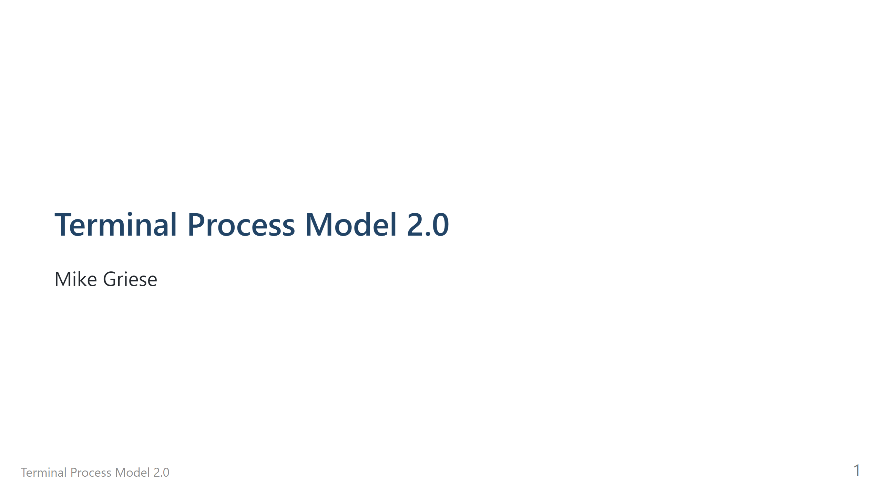

Slide 2
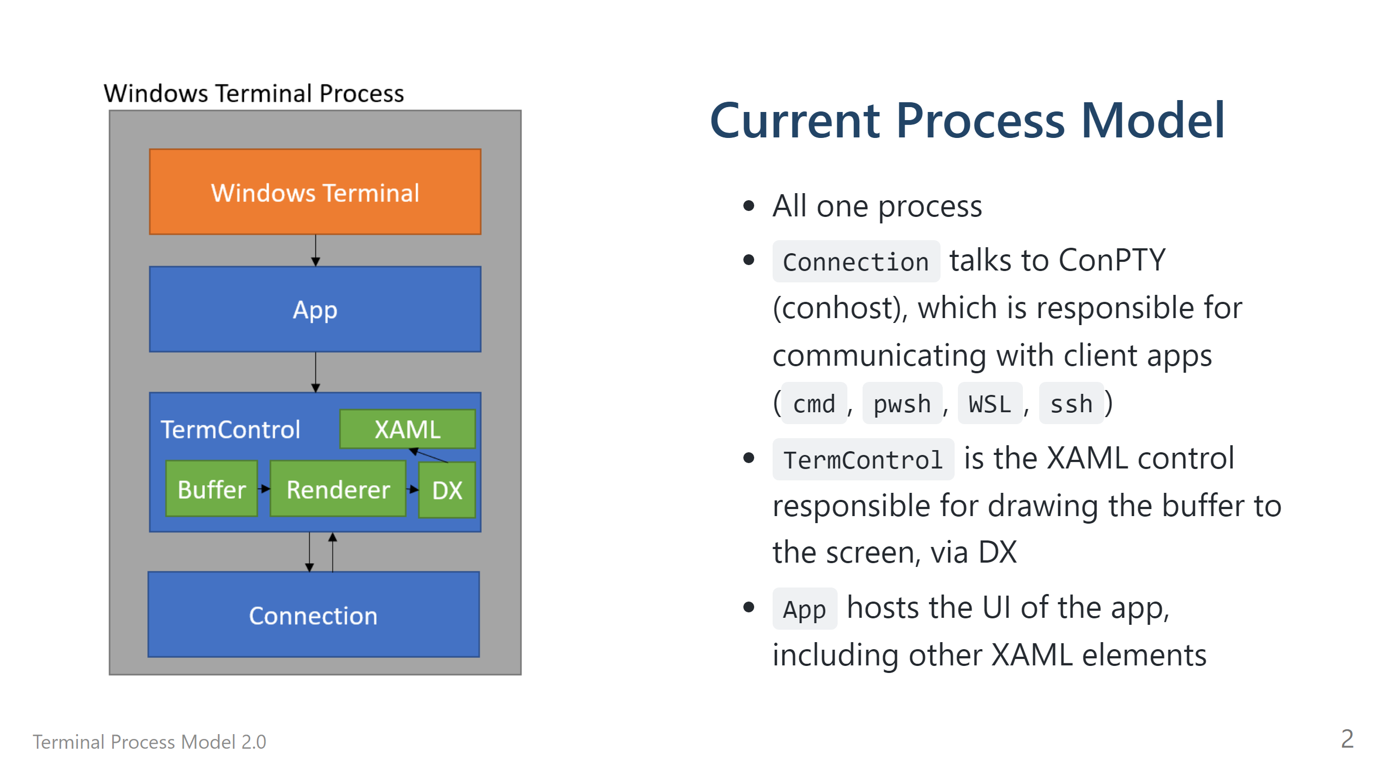

Slide 3
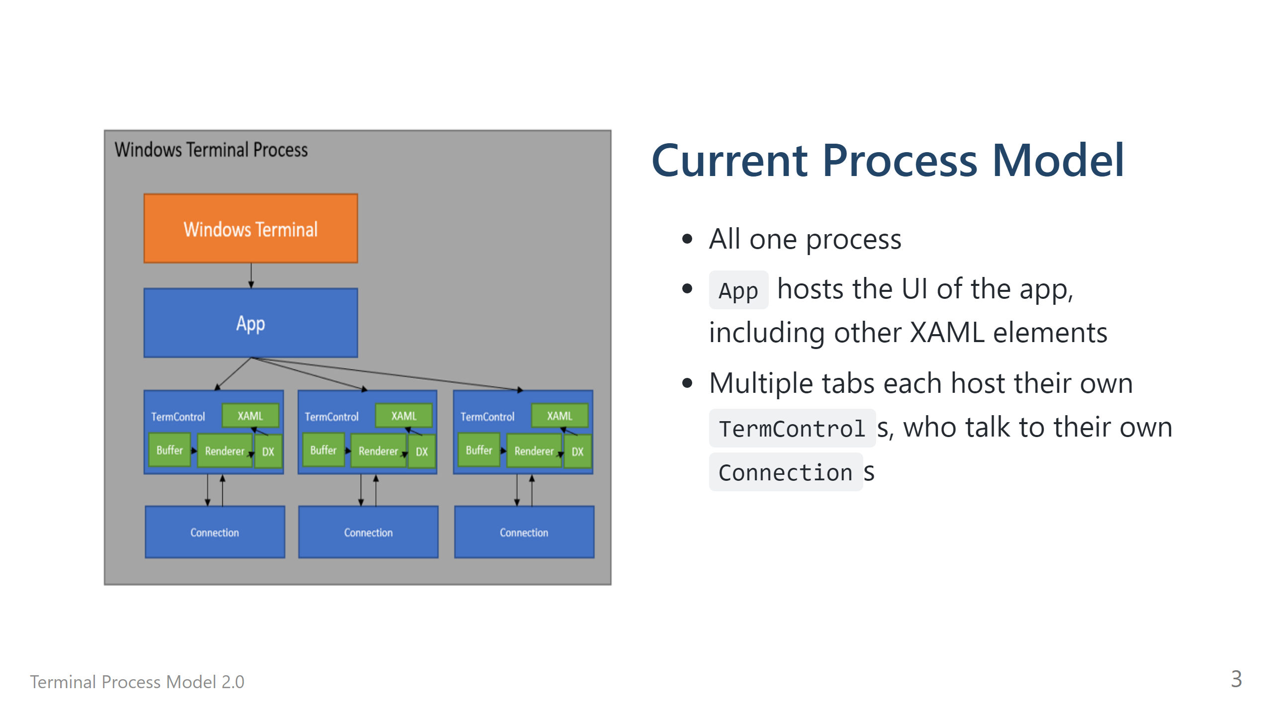

Slide 4
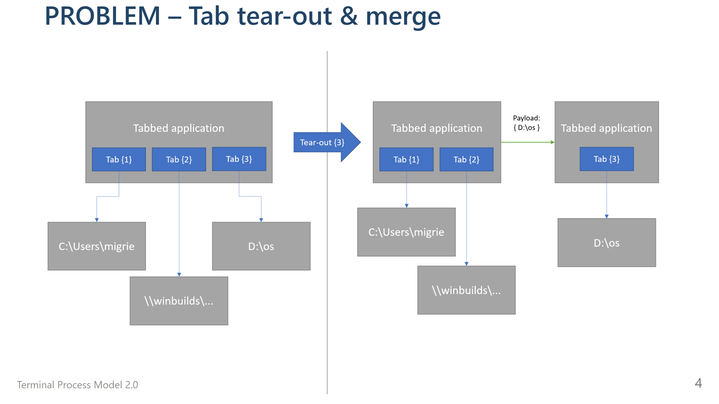

Slide 5
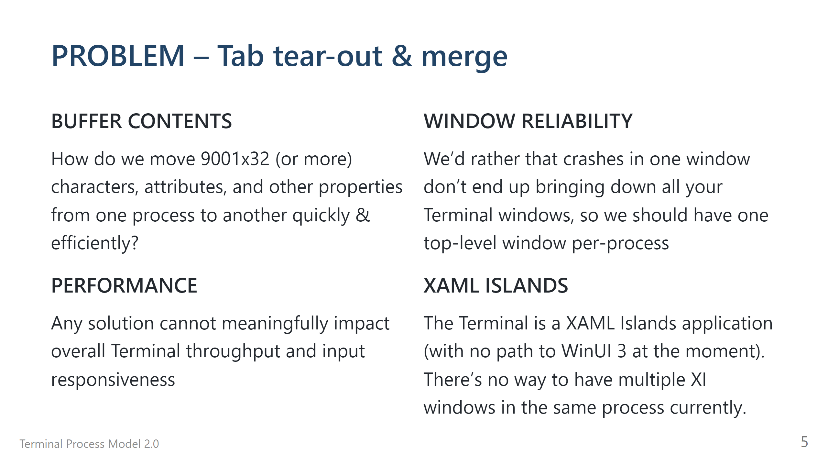

Slide 6
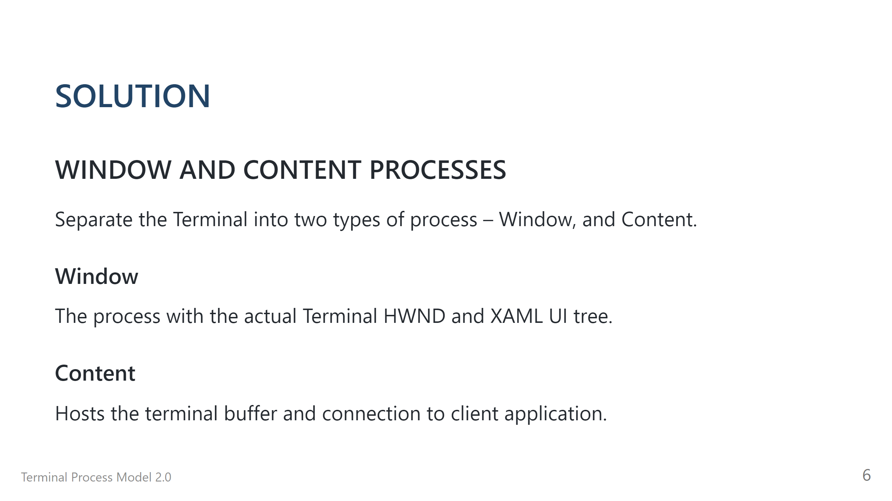

Slide 7
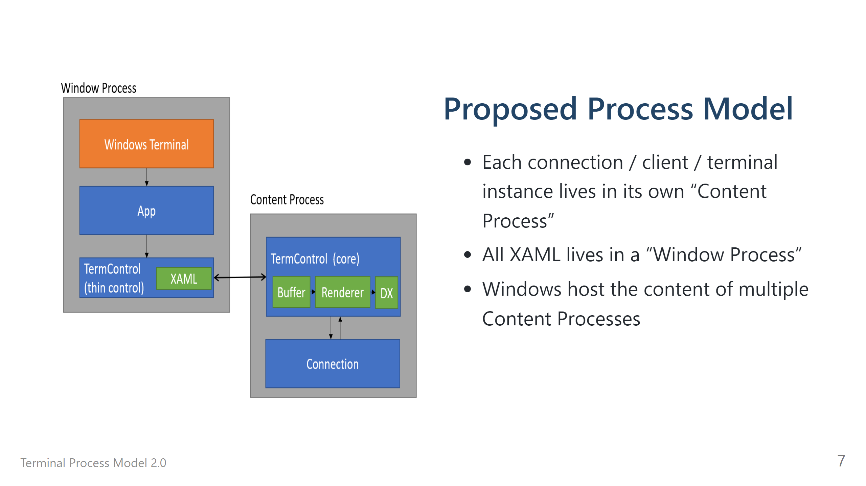

Slide 8
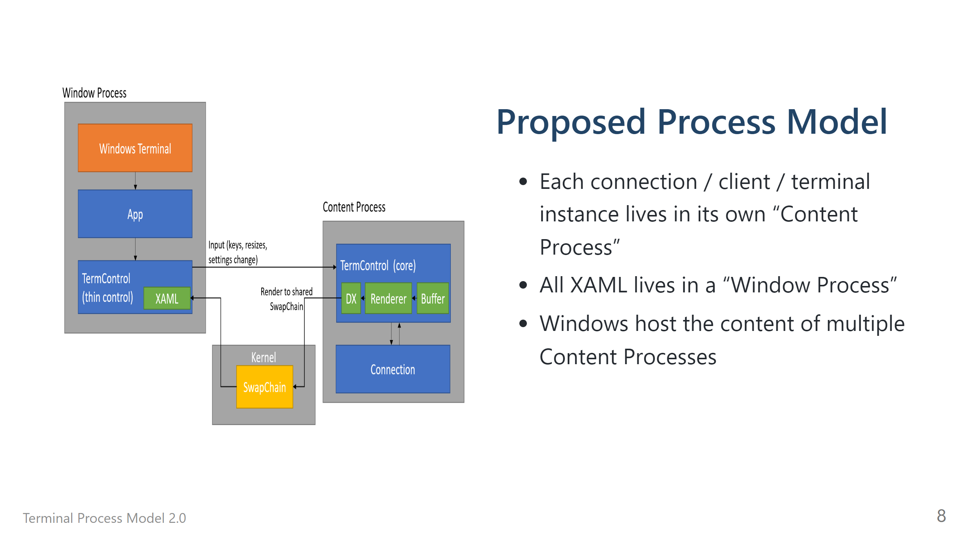

Slide 9
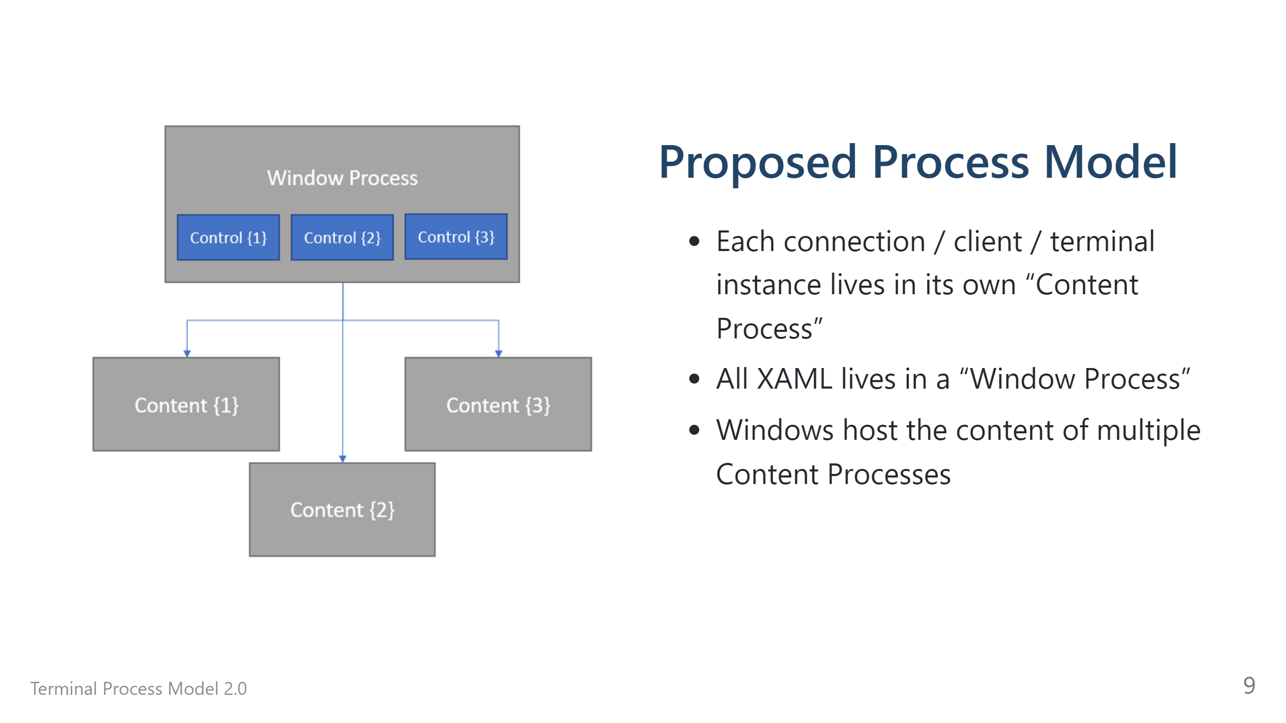

Slide 10
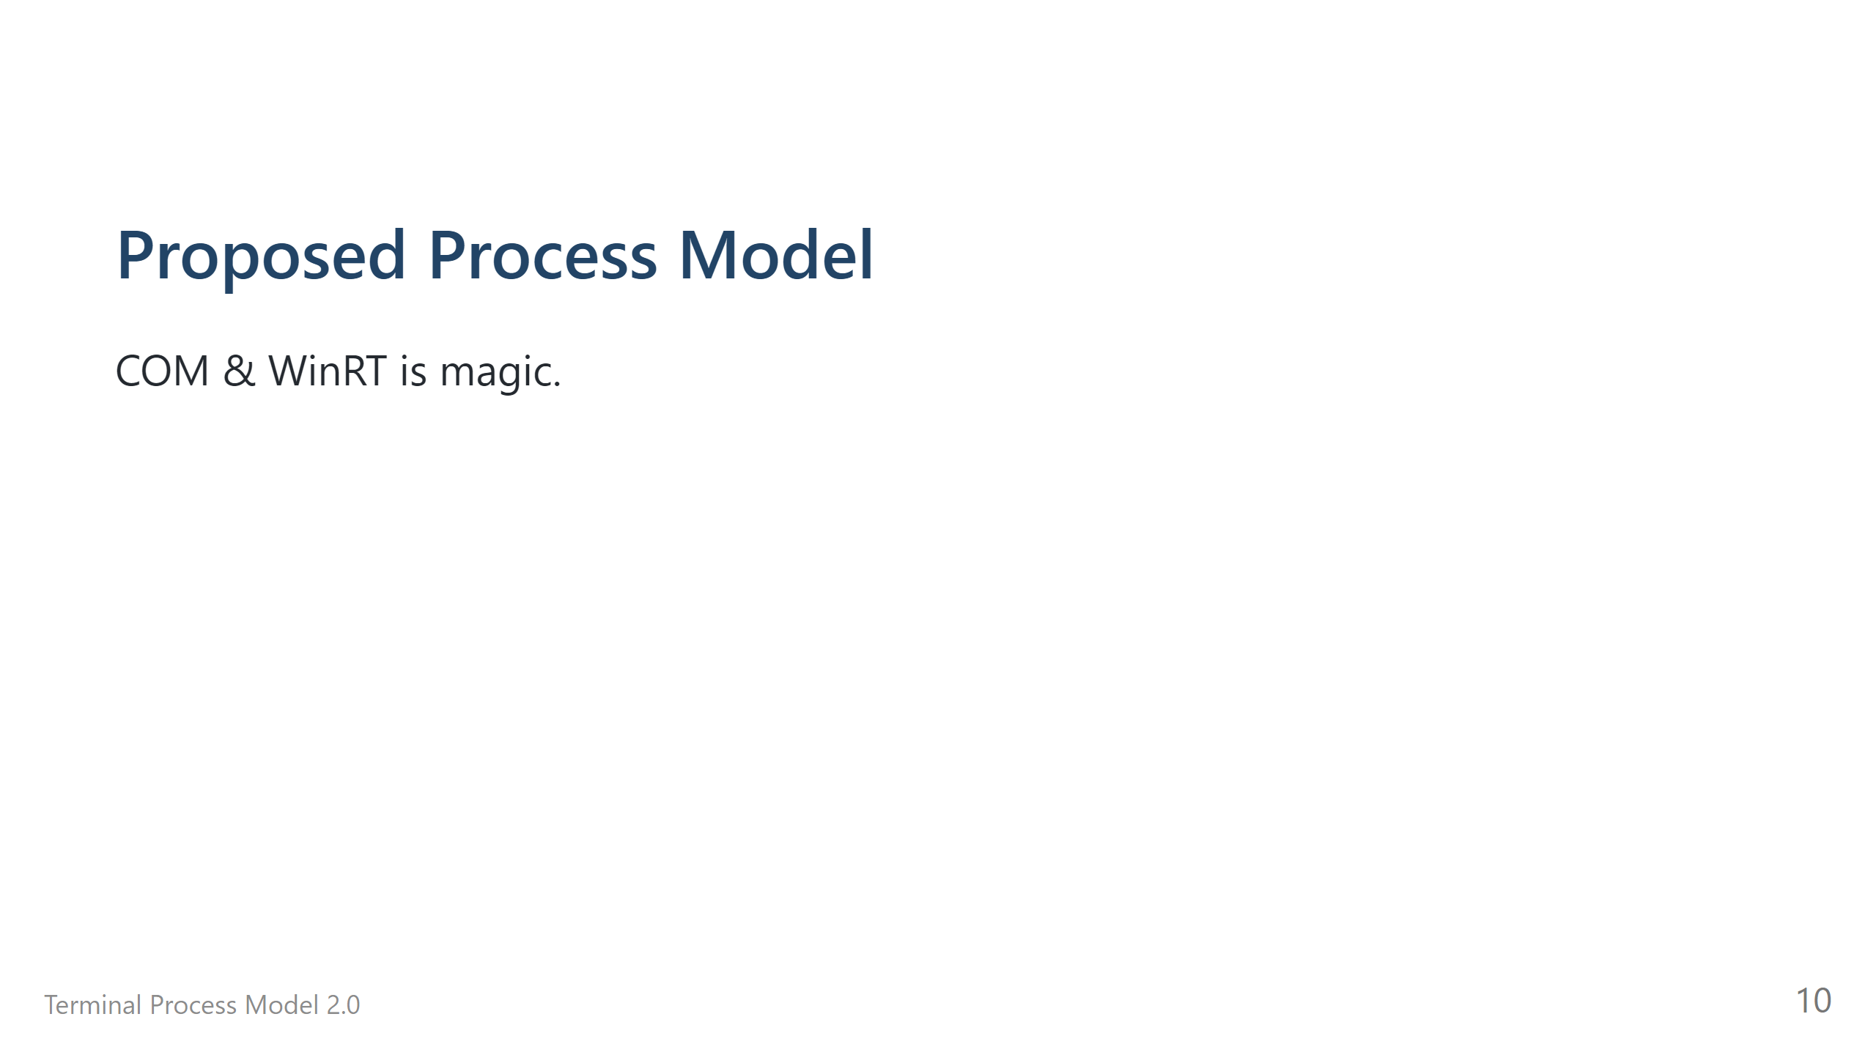

Slide 11
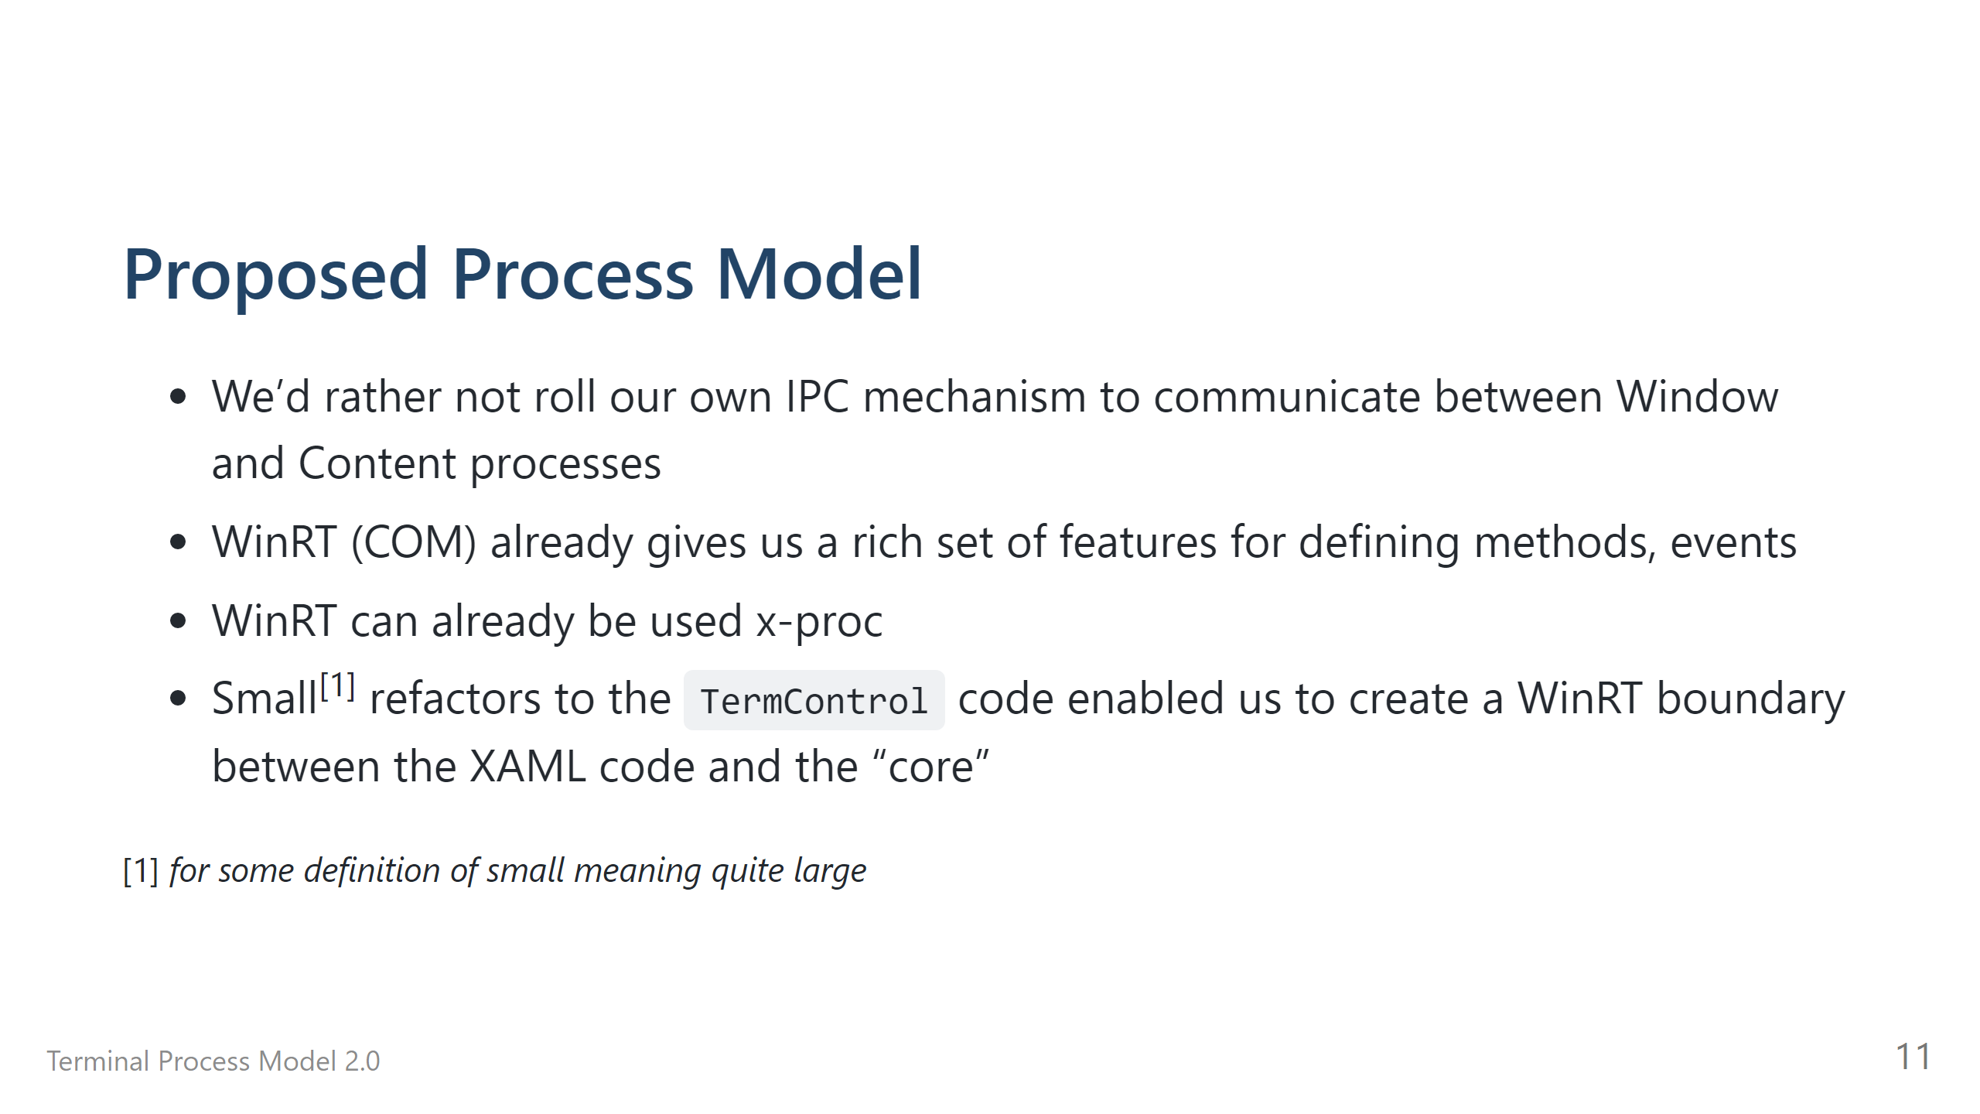

Slide 12

Notes:
# Proposed Process Model <img src="./figure-005.png" height="500px" width="600px">

Slide 13
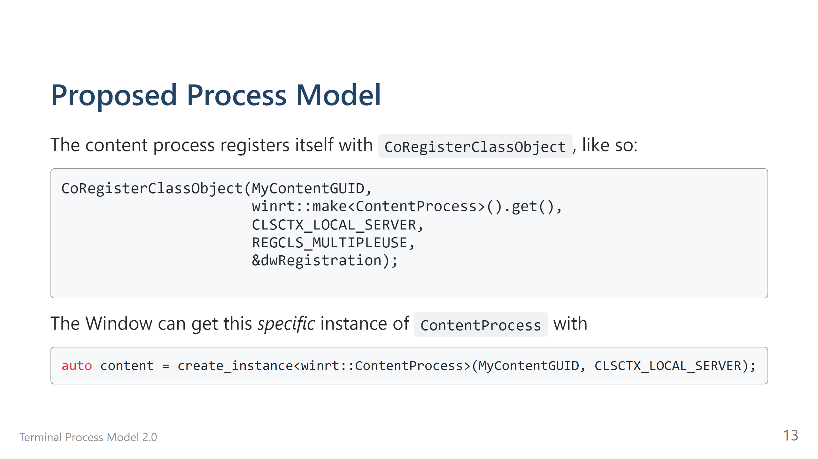

Slide 14
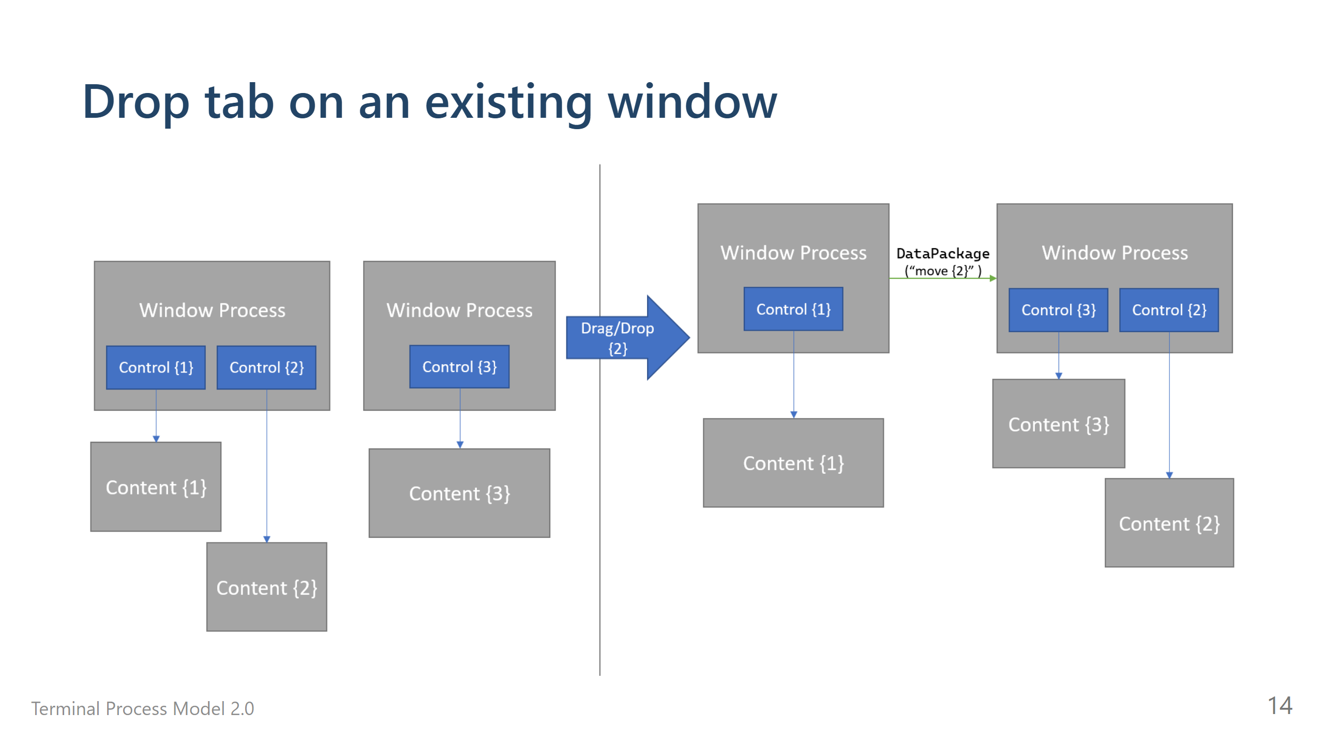

Slide 15
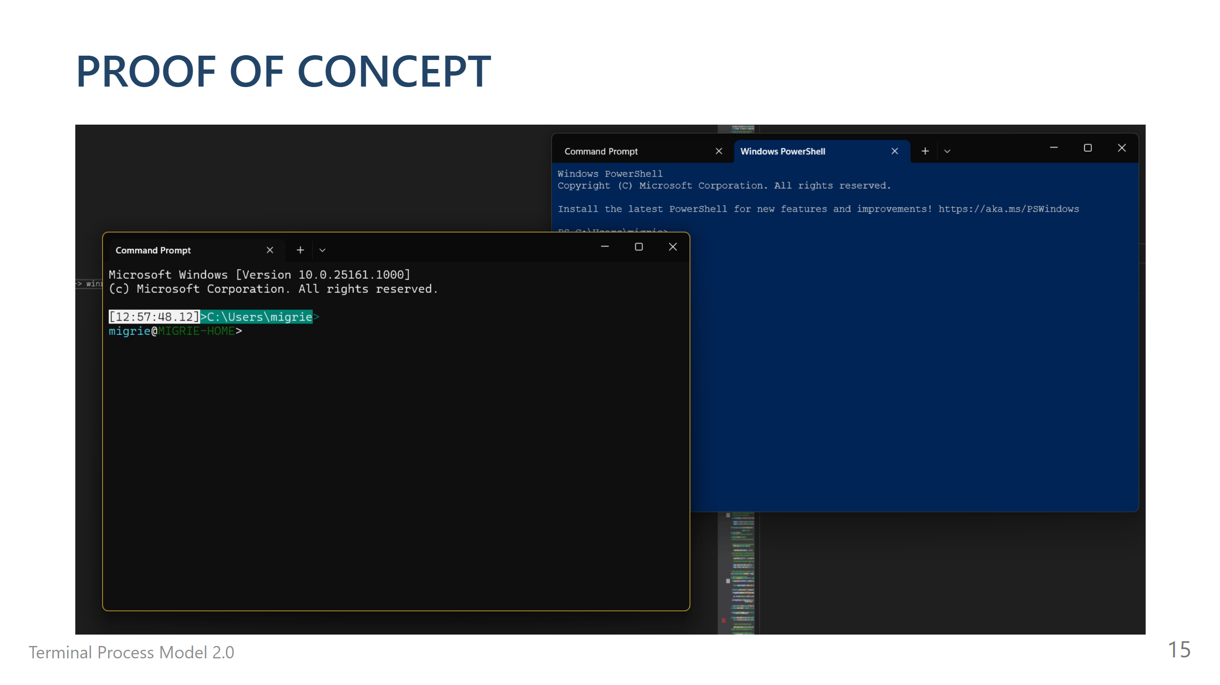

Slide 17
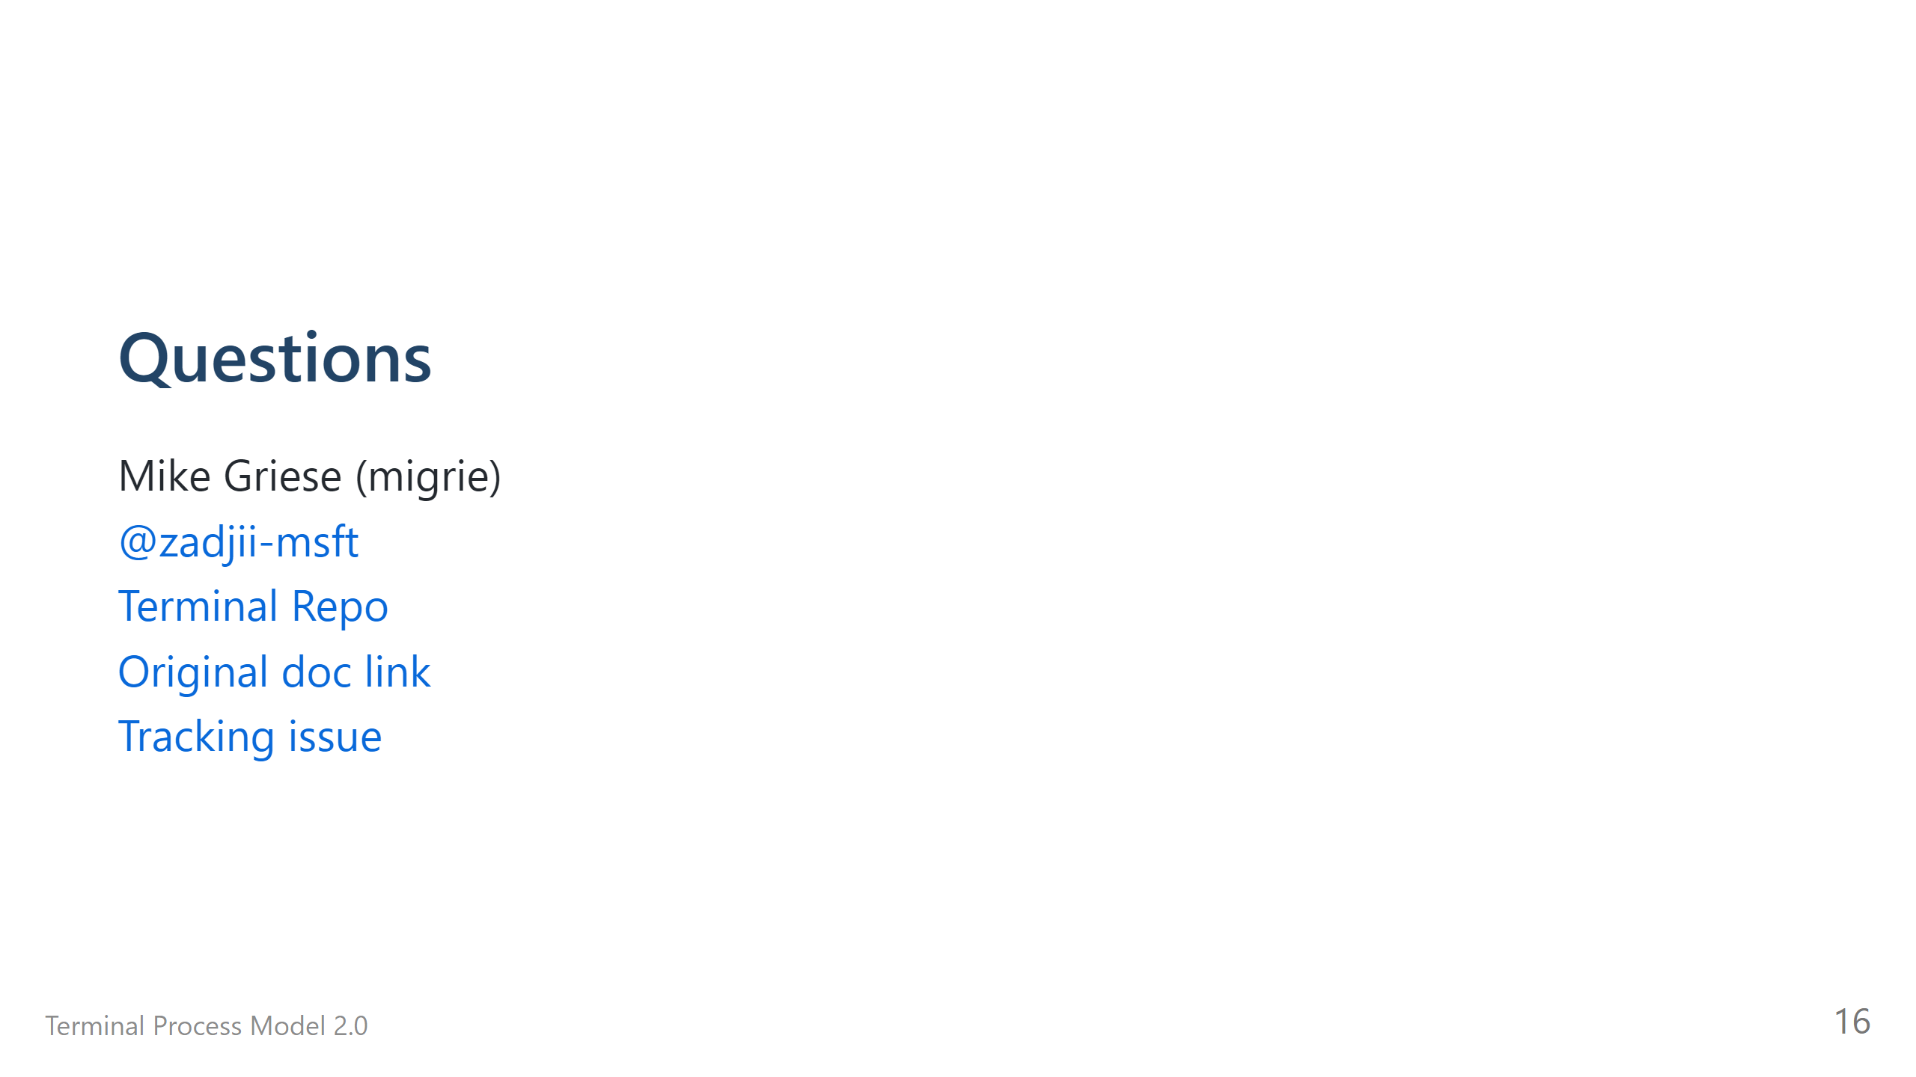

Slide 18
Questions
Mike Griese (migrie)
@zadjii-msft
Terminal Repo
Original doc link
Tracking issue (microsoft/terminal#5000)

Slide 19
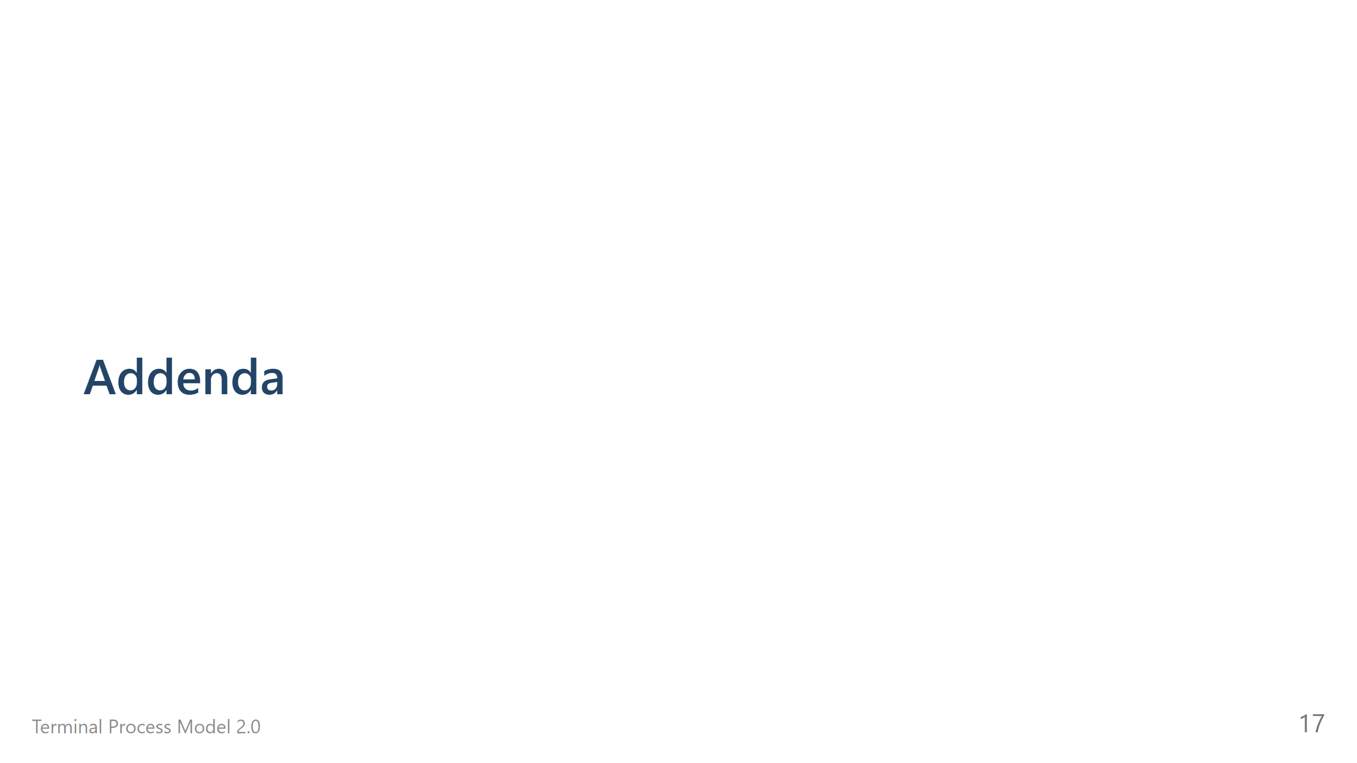

Slide 20
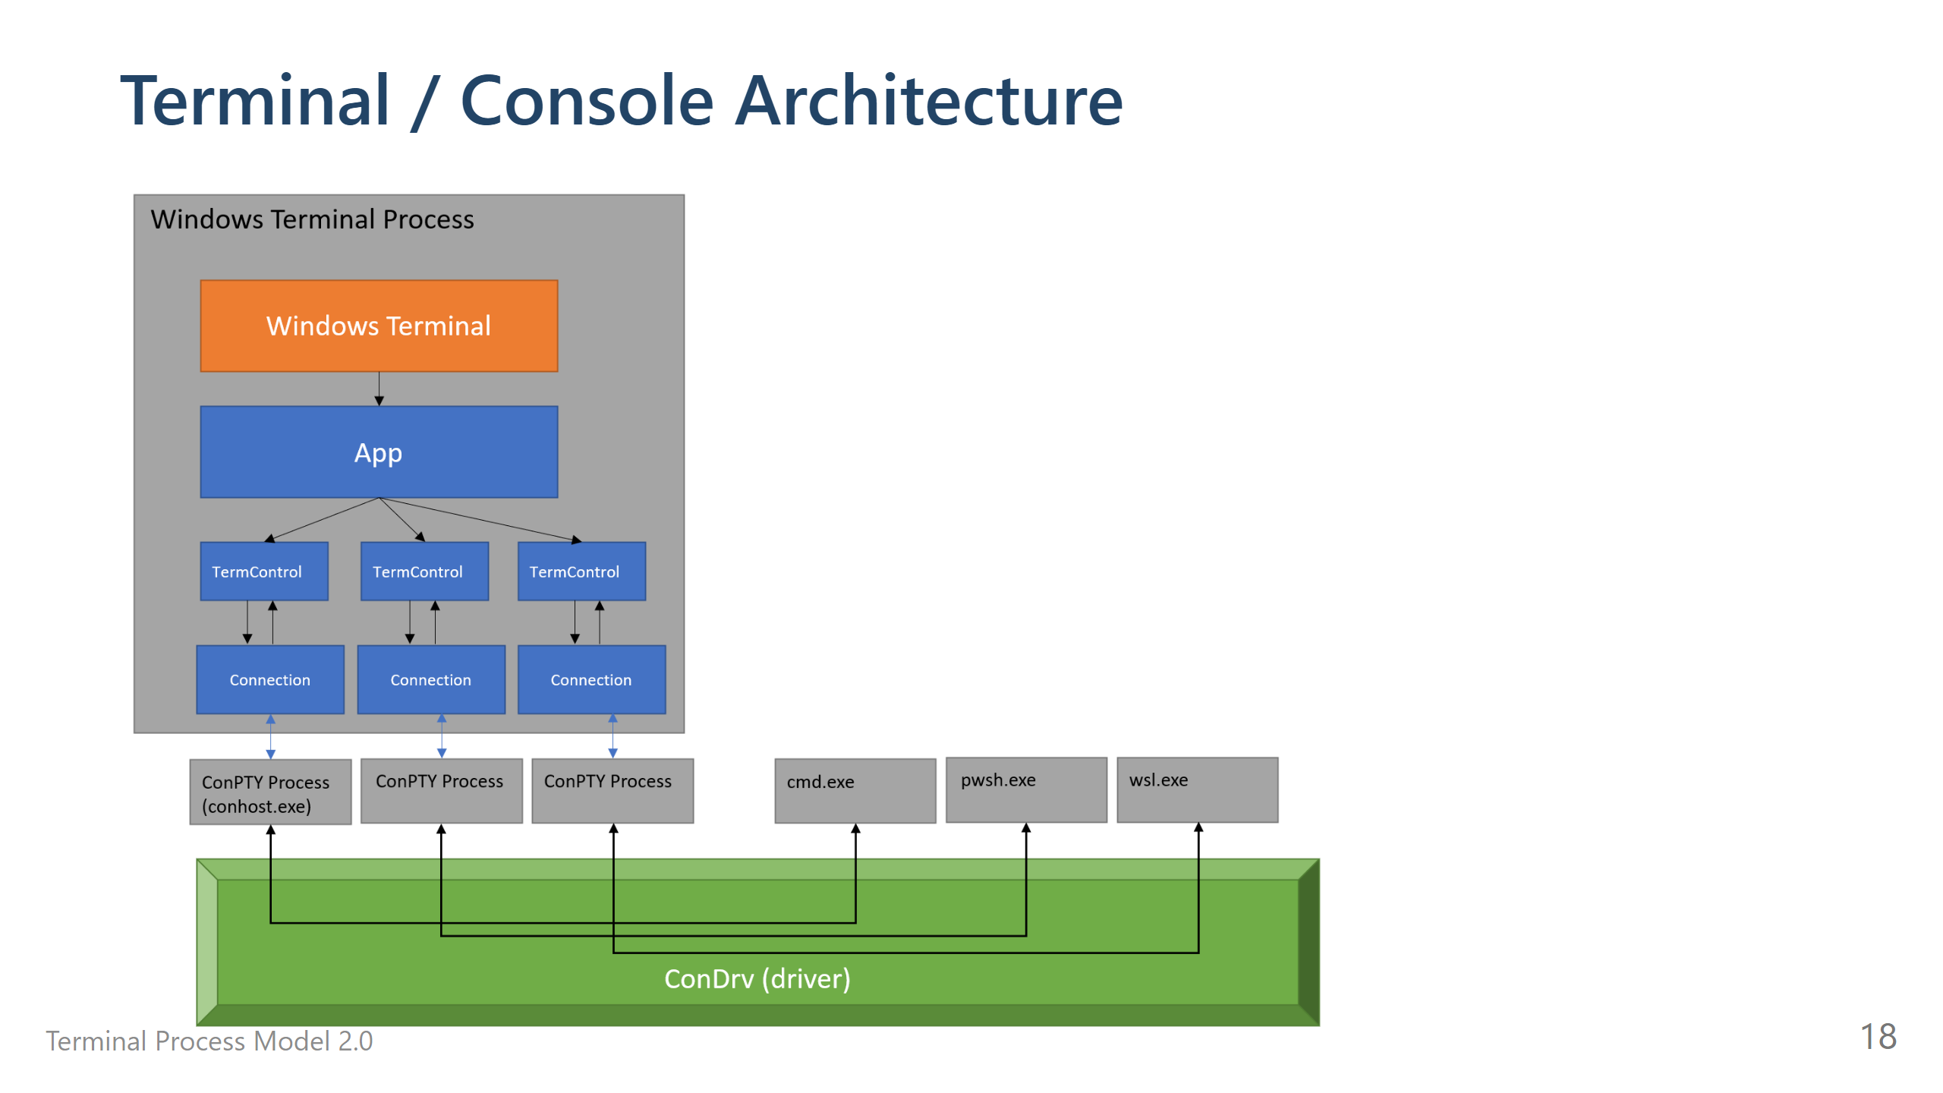
Notes:
# Window-Content IPC * We’d rather not roll our own IPC mechanism to communicate between Window and Content processes * WinRT (COM) already gives us a rich set of features for defining methods, events * WinRT can already be used x-proc * Small<sup>[1]</sup> refactors to the `TermControl` code enabled us to create a WinRT boundary between the XAML code and the “core” <sub> [1] _for some definition of small meaning quite large_</subs> --- # Serialization of a Tab? * TODO! * we used the existing serialization code, it was grand! ---

Slide 21
